Slide 1
Marching Band Informational
Thursday, March 2 at 6:30pm

Slide 2
Agenda
Introductions
What is Marching Band?
How can I get involved?
Student Commitment
Marching Band Financial Breakdown
But, wait….
Mattress Fundraiser
Final Announcements
Preview of 2017 Field Show

Slide 3
Introductions
Director: Lydia Lim
www.claytonbands.org
All Info, All payments, Contact Info, Pictures, etc…
Music Booster Executive Board
Marty Potter, President
Tina Laiho & MaryMac Propersi, Co-Vice Presidents
Corina Bonelli, Treasurer
Diane Wakefield & Rizalyn Andrews, Co-Secretaries
Streeta Farrell, Member at large

Slide 4
What is Marching Band?
2 Types: Parade and Field Show
Specific to MB: Drill, Music, Marching Instruments, Colorguard, Coaches, Competitions
Season: End of July – End of November
1 Semester Class, PE Credit
Comparable to a competitive sport

Slide 5
How can I get involved?
Music Boosters – all music parents
Volunteer at Football Games
Volunteer to donate water/snacks for students
Volunteer at competitions
Drivers for Trailer & Penske
Dinner Help
Moving equipment – percussion, podiums, sound
Volunteer to help with Lights, Camera, Auction
Booster Board Member

Slide 6
Student Commitment
Band Camp (no weekends)
Leadership Team – July 24 – August 4
Percussion/Colorguard – July 25 – August 4
Freshmen/Rookies – July 26 – August 4
Veterans – July 27 – August 4
All times are on google calendar on website
Rehearsals
Mondays & Fridays 3:30pm-6:00pm
Wednesdays 3:00pm-5:30pm
Home Football Games – Fridays 5:00pm – End of Half Time
Competitions & Marine Band Day

Slide 7
Student Commitments
Competition Day Breakdown: (* = parent volunteers needed)
All Day Saturday
Morning Rehearsal 9am-12pm
Bus leaves around 12:30pm/1:00pm*
Arrives at High School Competition 3:00pm
Unload Trailer/Penske 4:00pm*
Visual Warm Up – 4:45pm
Music Warm Up – 5:45pm
Standby 6:15pm*
Performance 6:30pm*
Dinner 7:00pm*
Load Trailer/Penske 8:00pm*
Awards 10:00pm
Depart HS 10:45pm*
Arrive at CVCHS 12:00am

Slide 8
Marching Band Financial Breakdown
1 All-Inclusive Marching Band Fair Share Contribution
Yearly Operating Expenses
Coaches – Band Camp
Coaches - Season
Transportation – 4 Competitions & Marine Band Day & Penskes
Colorguard Equipment/Instrument Repairs
Trailer Maintenance
Uniform Cleaning
Show Shirts
Gloves
Shoes
Dinners @ all Competitions
Breakeven: Cost per student approx. ~ $720

Slide 9
But Wait…
Music Boosters Fundraisers:
Lights, Camera, Auction – November 4, 2017
Mattress Fundraiser – March 26, 2017
Grants
Donations from local organizations
Marching Band Fair Share Contribution for 2017: $500
Payment plan– on website (paypal fees)

Slide 10
Mattress Fundraiser
March 26, 2017 – CVCHS Large Gym – 10:00am-5:00pm
Tim McWade

Slide 11
Final Announcements
http://bit.ly/2mmLOEU
New Uniforms, New Sound System, New Marching Brass Instruments, New Front Ensemble Equipment
Wind Ensemble and Jazz Band audition material up on website – audition week: April 24 – 28
AP Music Theory & Jazz Band are switching periods (0 & 6)
Registration for Middle School Band Camp! (price goes up April 1)

Slide 12
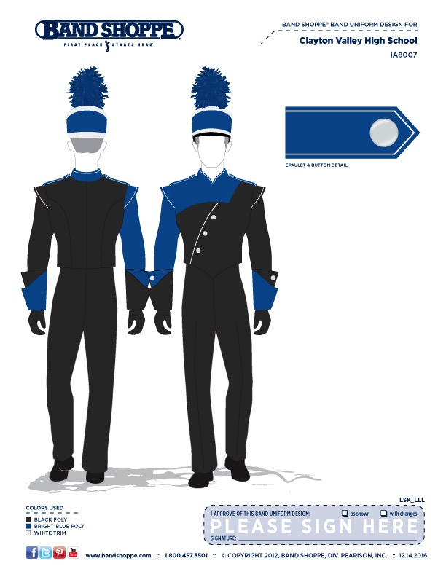
New Uniform
Jackets
Bibbers
Gauntlets
Plumes

Slide 13
Field Show 2017

Slide 14
Field Show 2017
First Movement: https://www.youtube.com/watch?v=kbQH32MG5_s

Slide 15
Thank you so much!
Questions: Lydia.lim@claytonvalley.org

